Slide 1
Fault Tolerance System for Aerial Vehicles
By Team Airborne
MGIT
Nampally Rahul
K. Saathvik Vardhan
Kukkadapu Sai Vinay

Slide 2
PROBLEM STATEMENT
Problem Statement no. 50 - Open Hardware Real-World System
Modern aerial systems such as advanced drones and eVTOL platforms rely on traditional real-time operating systems like VxWorks, INTEGRITY RTOS, PikeOS, and Deos RTOS to achieve deterministic real-time performance.
However, these systems are built on static and tightly coupled architectural models, which impose significant limitations for next-generation, high-compute aerial platforms.
To address the limitations of traditional avionics RTOS architectures, this project implements a modular fault tolerance system in flight controllers on a Raspberry Pi 4 using QNX Neutrino RTOS, leveraging its microkernel architecture and synchronous message-passing IPC.
2

Slide 3
Fault-Tolerant Real-Time Communication in QNX (RPi 4)
Platforms : Respberry Pi 4
RTOS : QNX Neutrino
Sensor : MPU9250 (I2C)
FOCUS :
IPC(Message Passing)
Fault Tolerance
Latency & Jitter Analysis
CPU Performance Monitoring
3

Slide 4
SYSTEM ARCHITECTURE
Components
Sensors:
Actuators:
Process 2 (Client)
Reads MPU9250 via I2C
Process 1 (Server)
Receives data via message passing
Monitor Logic
Detects failure & restarts client
NEO-M8N → Global positioning
MPU9250 → Client → Server
MS5611 → Altitude estimation
HMC5883L → Heading detection
BLDC Motors via ESC
Key Design
Communication:
Controller:
Fully process-based (no shared memory for IPC)
Modular & restartable
I2C → Barometer & Magnetometer
iBUS → Receiver input
SPI → IMU
UART → GPS
Raspberry Pi 4
4

Slide 5
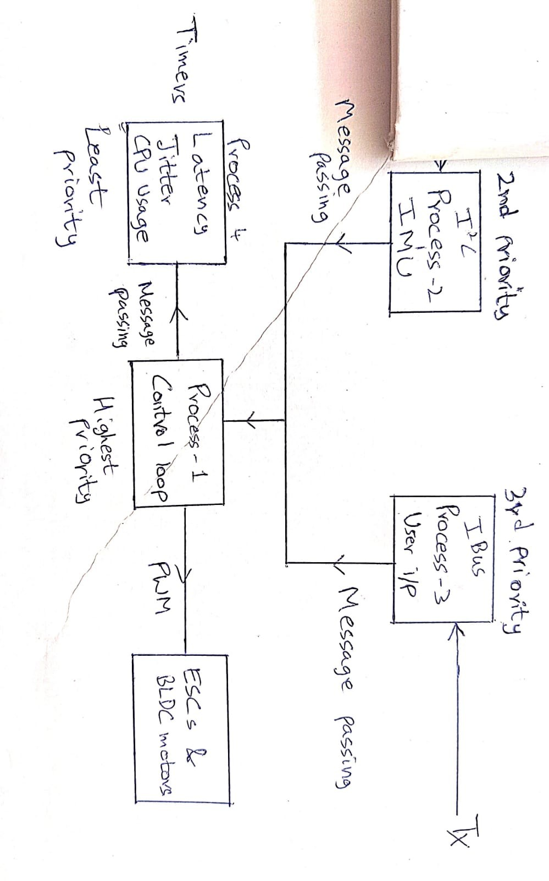
5

Slide 6
IPC – Message Passing
Mechanism
MsgSend() → Client sends data
MsgReceive() → Server receives
MsgReply() → Acknowledgement
Advantages
Synchronous → deterministic
Built-in priority inheritance
No race conditions
Sensor data transferred reliably
No shared memory dependency
6

Slide 7
Fault Tolerance Mechanism
1. Problem
Client may stop sending data
2.Solution
Server monitors message arrival time
If timeout occurs:
Restart client process
3.Implementation
Timeout detection using timers
Restart using process control
4.Result
Self-healing system
No full system restart needed
7

Slide 8
Process Restart (Spawn & Slay)
Slay
Terminates faulty client
Spawn
Used to create client process
Enables dynamic startup
Workflow
Detect timeout
slay client
spawn client
Benefit
Fault isolation
Continuous operation
8

Slide 9
Latency Measurement (Timers)
What is Latency?
Time from:
Client send → Server receive
Implementation
Using Timers:
ClockCycles
Timestamp at:
Send
Receive
Output
Latency in ms/µs
Importance
Validates real-time performance
9

Slide 10
Jitter Measurement
What is Jitter?
Variation in latency over time
Calculation
Jitter = variation between consecutive latencies
Implementation
Store previous latency
Compute difference
Optional Enhancement
Use shared memory + mutex:
For logging/analysis
Importance
Stability of control systems
10

Slide 11
CPU Usage Measurement in QNX
Methods
1. Using pidin
Command:
pidin -p <pid> times
Shows CPU time per process
2. Using top
Real-time CPU usage view
3. Programmatic Method
Use:
ClockCycles()
clock_gettime()
Formula
CPU Usage = (Process Time / Total Time) × 100
11

Slide 12
Results & Key Outcomes
Reliable IPC using message passing
Fault-tolerant restart mechanism
Measured:
Latency
Jitter
CPU usage
Deterministic communication
Modular design
Real-time validation
12

Slide 13
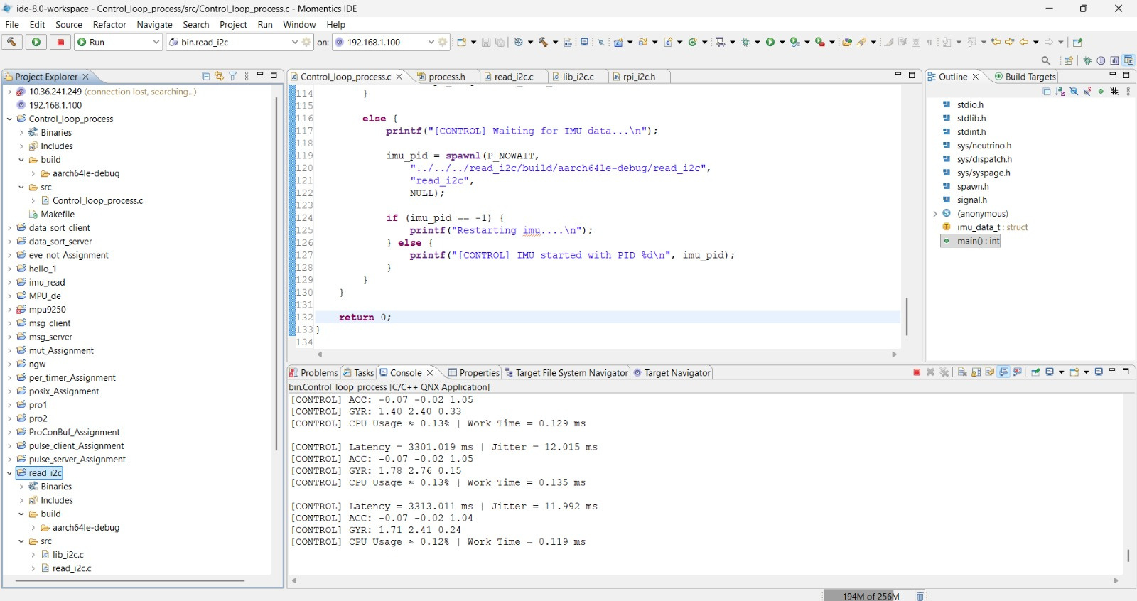
13

Slide 14
14

